Slide 1
Tutorial 1 Learning Topology Optimization Through Examples and Case Studies
August 18, 2019

Slide 2
Problem Statement
Cantilever Beam Problem
Units: MKS
Material: AlloySteel
Structural Loads: 1000N
TopOpt Constraints: Multiple
Objective: Minimum Compliance
Goal: Optimize the topology for a volume fraction of 0.25
1000N
Optimize the geometry with
Extrusion Constraint
Draw Direction Constraint
AM Constraint
Symmetry

Slide 3
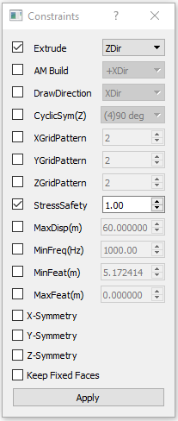
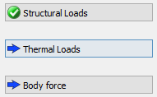
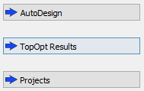
Minimum Compliance
Choose Units
Load Geometry
Define Material
Apply Loads (Structural/Thermal/Gravity)
Carry out FEA
Apply Top Opt Constraints
Topology Optimization
PostProcessing

Slide 4
Extrude Cut Constraint

Slide 5
AM Build Direction Constraint

Slide 6
Draw Direction Constraint

Slide 7
Cyclic Symmetry Constraint
Multiple Constraints!
Be careful with conflicting constraints!

